Slide 1
Comparing SHAP and LIME on Real-World
Tabular Classification Tasks
Mauricio Monje, Sebastian Mejia, Aditya Dwivedi

Slide 2

Overview and Problem with MLs
With recent breakthrough developments on machine learning models, we see that the prediction results are relatively accurate and powerful. But, we don’t really know how the prediction even came to be.
Although we might know what’s going on conceptually, we don’t actually see the decisions being made, such as in a random forest when it breaks down how it’s predictions are made.
The problem with a lack of understanding is that it can lead to confusion, mistakes or lack of trust with the overall concept. We do want to see sectors grow and expand in their productivity with MLs (e.g., healthcare, finance, etc), but we do understand the reasoning for not fully adopting it.

Slide 3
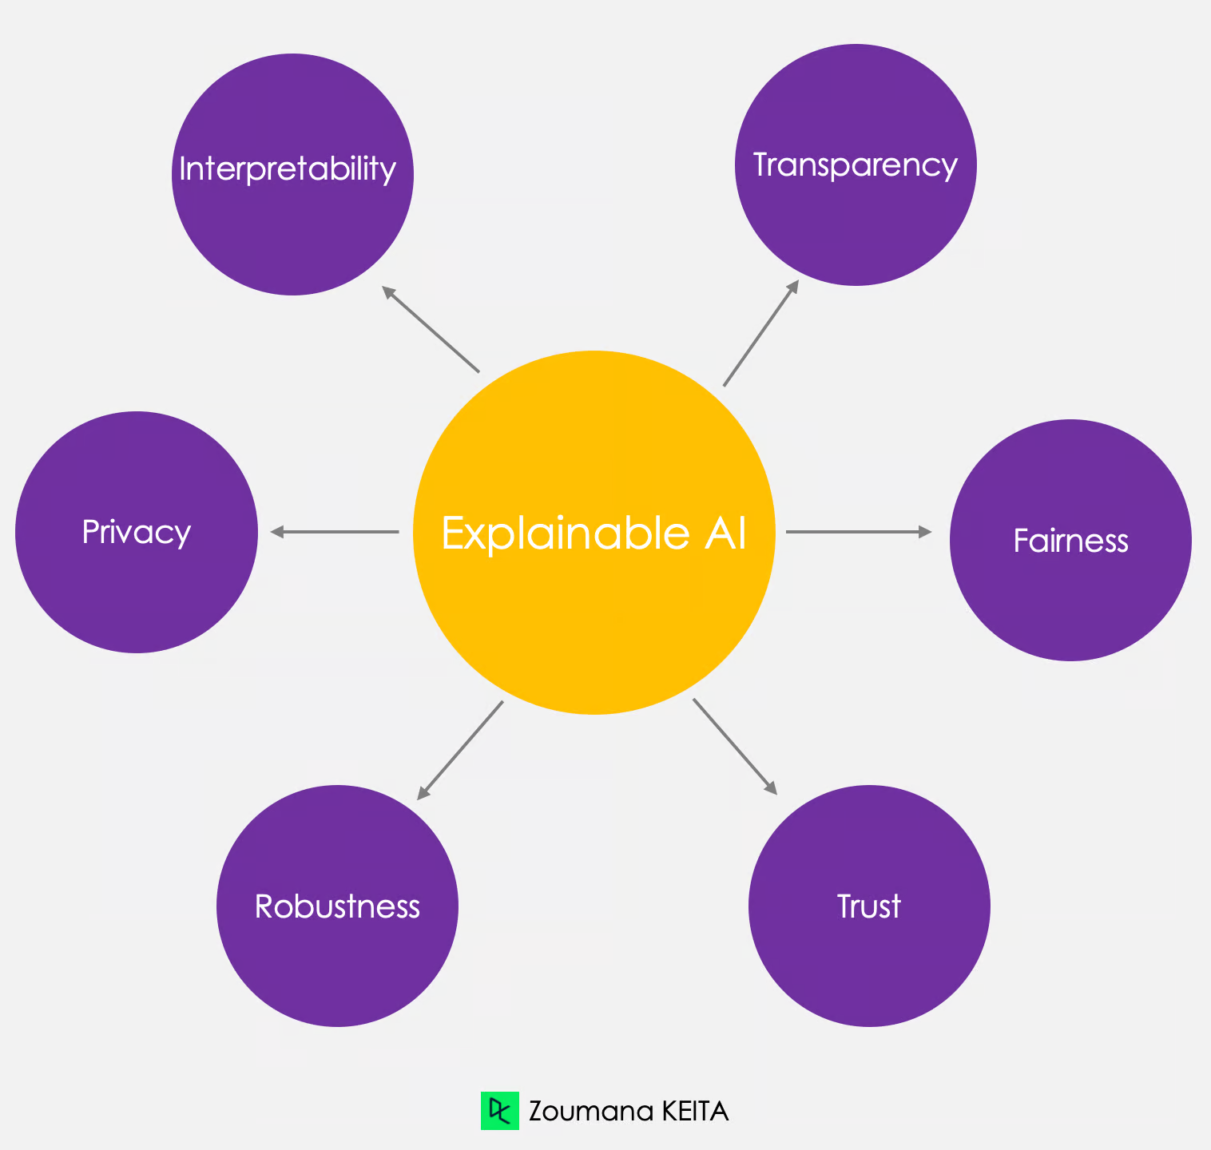
Explaining Machine Learning Prediction: SHAP vs. LIME
A solution to the problem is creating something that would explain how those model predictions came to be. This is where SHAP (SHapley Additive exPlanations) and LIME (Local Interpretable Model-Agnostic Explanations):
SHAP: An explainability method based on game theory, specifically on Shapley values. Basically, it works by calculating the contribution of each feature to a model’s prediction, taking into account all possible combinations of feature inputs.
LIME: This method explains individual predictions by creating a simple, interpretable model, such as linear regression, around the prediction in question. It does this by slightly altering the input data and observing how the prediction changes. The advantage to this method is that it is generally faster and easier to use than SHAP, but its explanations can be less stable or constant depending on how the data is sampled.

Slide 4

Research and Studies
Before we approach it “head-first”, we want to get a complete understanding of what we’re working with:
When we want to quantitatively evaluate the accuracy of SHAP and LIME; SHAP, almost always, performs much more reliably than its counterpart.
But, when intentionally set-up in a framework where it’s meant to deceive SHAP and LIME, they perform much more poorly and allowed biased classifiers to produce misleading explanations to MLs. This was seen on a dataset regarding credit scores and criminal justice, which are sectors we want to see more MLs be used in.
LIME is generally faster and easier to run, making it much more viable option to those who don’t need a powerful and detailed options like SHAP.

Slide 5
Pathway and Plan for Experimenting
We’re choosing three datasets from sectors that are new and old to test the range that both methods are capable of working with, while also ensuring that they have numerical and categorical features.
After that, we’ll perform EDA to see feature distributions, check for correlations, and handle missing values.
For the sake of brevity, all data values will be preprocessed with one-hot encoding, standardized for their numerical values, and split each dataset into training and test sets.
The two models we’ll be training is Logistic Regression and Random Forest.
Lastly, we’ll apply SHAP and LIME to explain how those two models came to their conclusion.

Slide 6
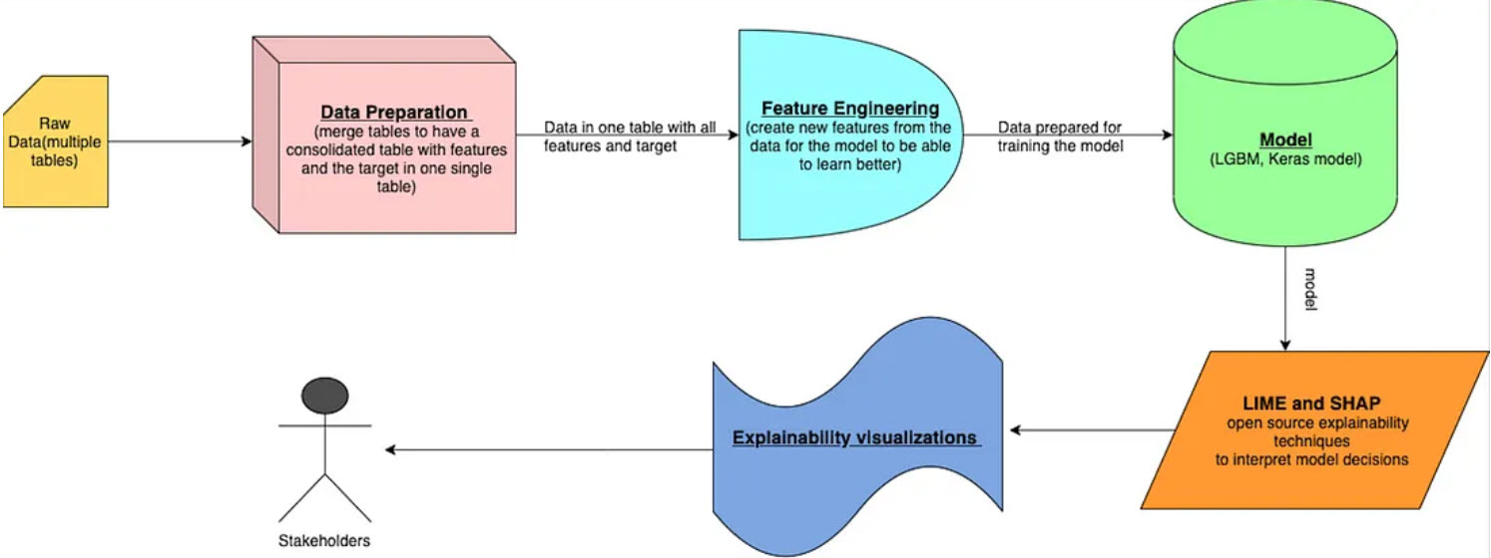
EXAMPLE VISUALIZATION

Slide 7
Context on the Data sets (all from HuggingFace)
Heart Disease Dataset
Predicts whether a patient has heart disease based on age, chest pain type, cholesterol, ECG, etc.
Titanic Survivors Datasets
This dataset is the Titanic survival dataset and is used to see which passengers were more likely to survive.
Student Alcohol Consumption
Predicts final grade of students using features like alcohol use, family background, absences, and study time.

Slide 8
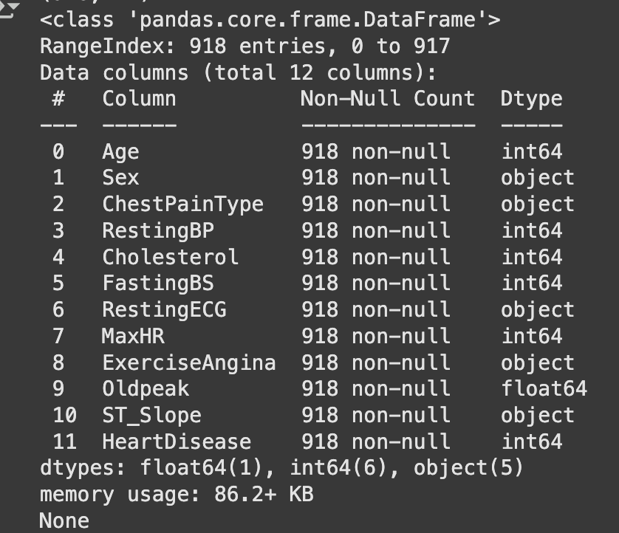
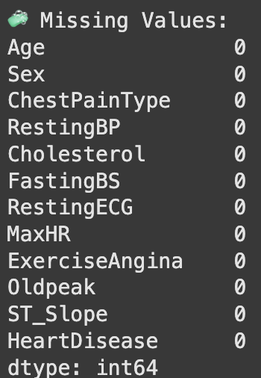
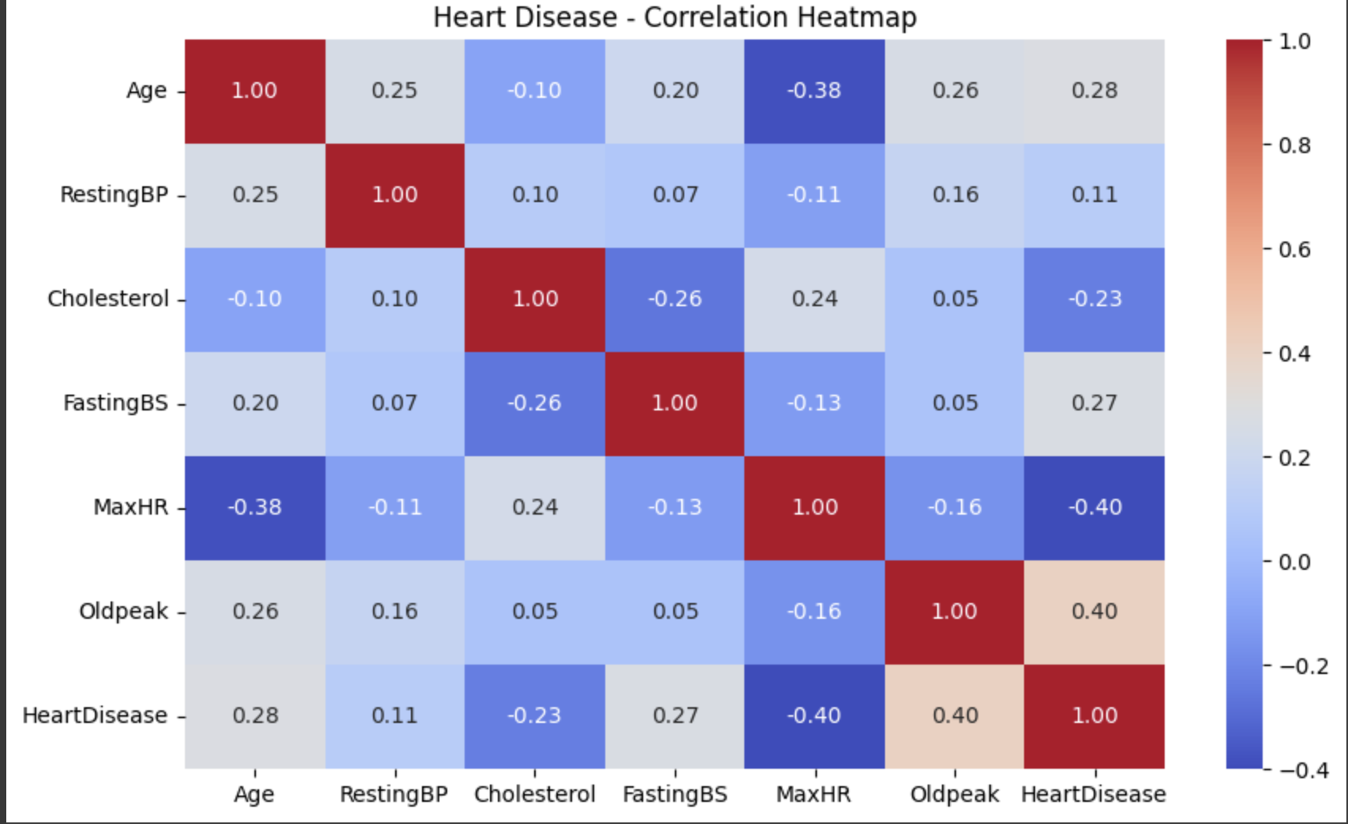
EDA on Heart Disease Dataset

Slide 9
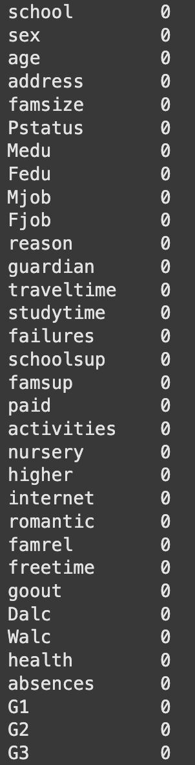
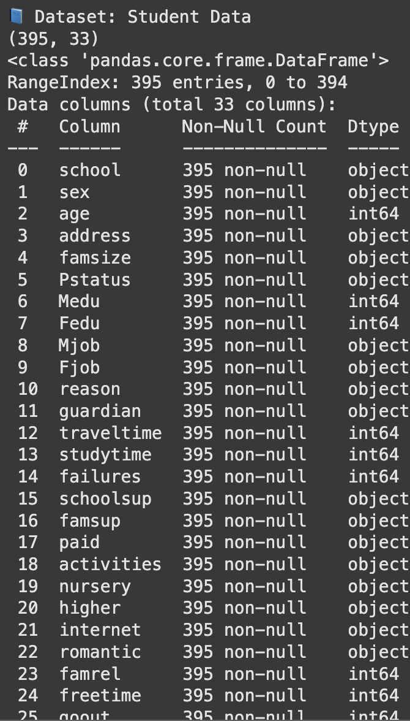
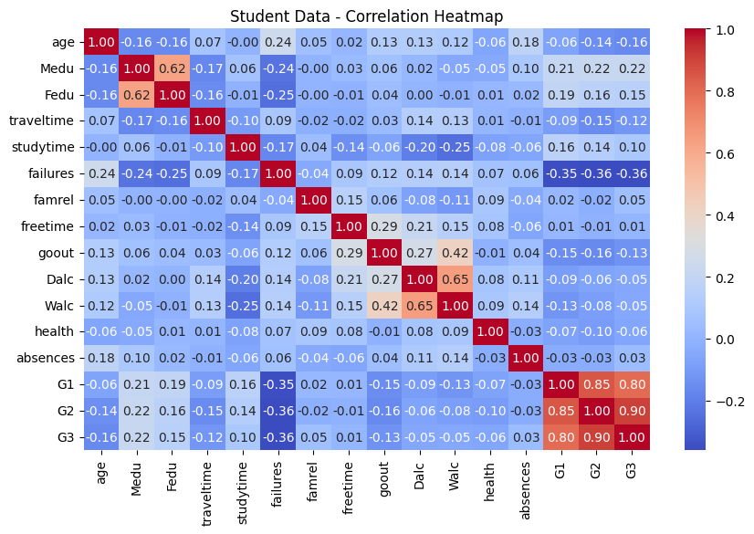
EDA on Student data

Slide 10
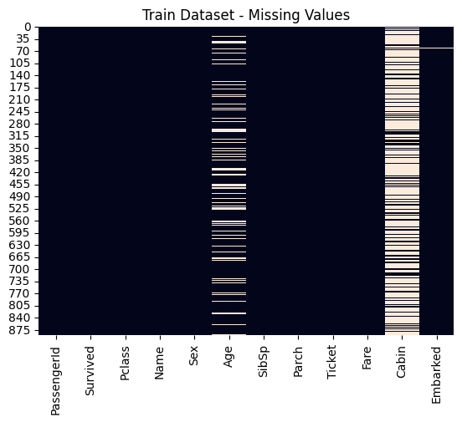
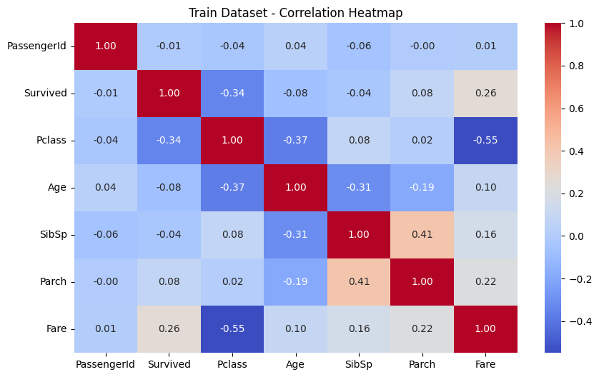
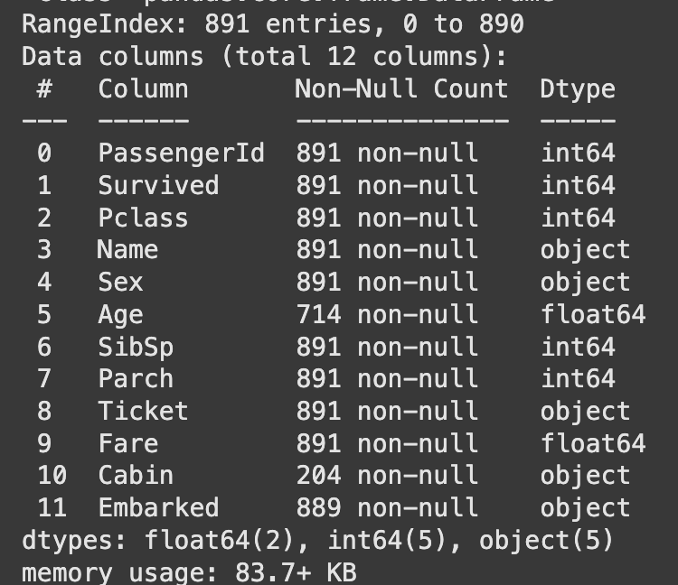
EDA on Titanic Dataset

Slide 11
Methodology and Data Preparation
Datasets Used
Heart Disease (binary classification)
Student Performance (grade prediction)
Data Processing
Standardized numerical features (mean ≈ 0, std ≈ 1)
Encoded categorical variables
Models Implemented
Logistic Regression (baseline)
Random Forest (complex relationships)
Performance
Heart Disease: Logistic=0.886, Forest=0.875
Student Grades: Logistic=0.620, Forest=0.633

Slide 12
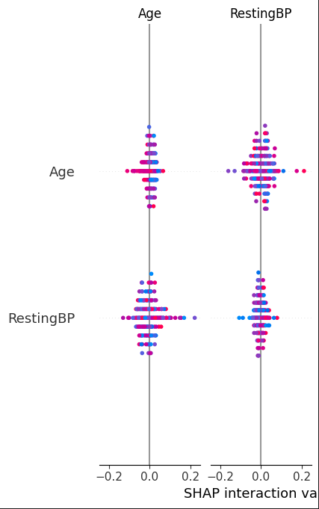
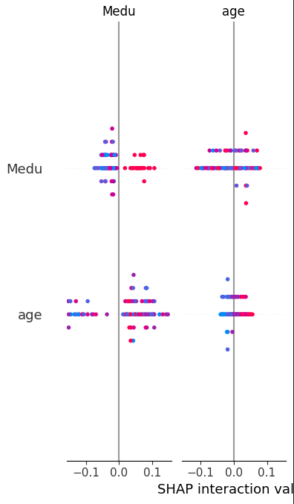
XAI Implementation and Results
Heart Disease Model:
Balanced feature effects: RestingBP (+0.05), Age (-0.05)
Model demonstrated nuanced risk assessment (p=0.552)
Validated known medical relationships
Student Performance Model:
Mother's education and age emerged as key interacting factors
Revealed need for age-specific educational support
Guided subsequent feature selection

Slide 13
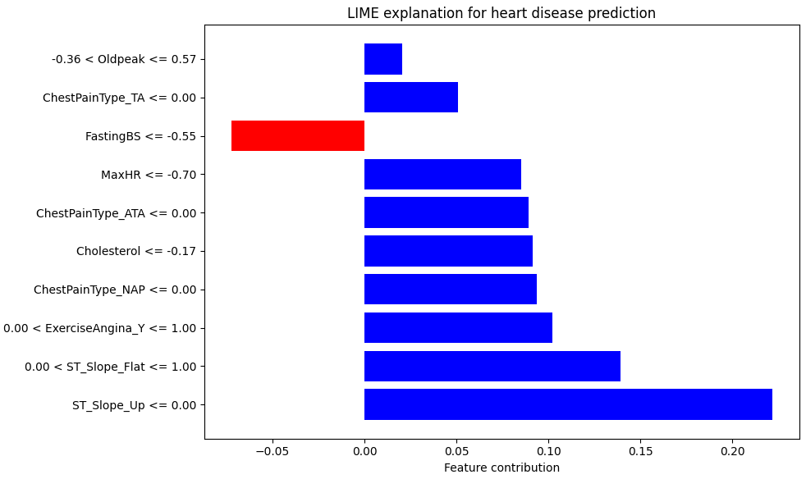
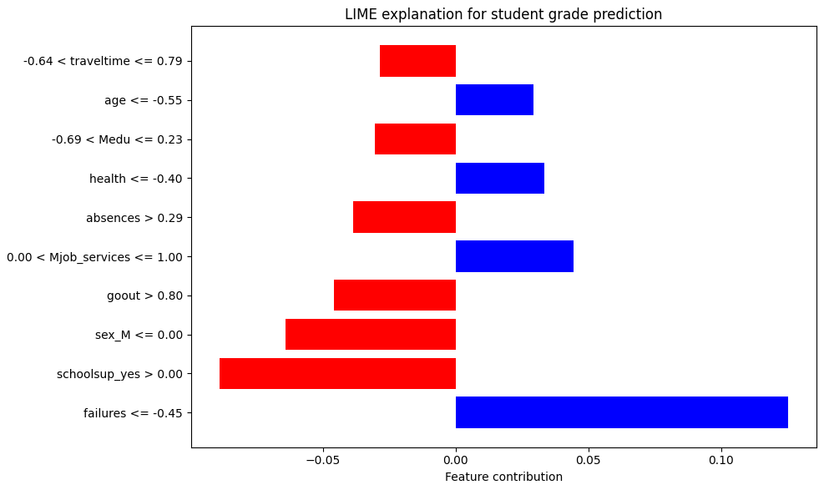
LIME Insights
Heart Disease Analysis:
ST_Slope patterns crucial (0.20 contribution)
Confirmed SHAP findings on Exercise Impact
High confidence prediction (0.960 probability)
Student Performance:
Previous failures most influential (+0.10)
School support factors significant
Moderate prediction confidence (0.380)

Slide 14
Comparative Analysis
Method Strengths
- SHAP: Robust global insights, quantifiable impacts
- LIME: Intuitive local explanations, stakeholder-friendly
- Combined: Comprehensive understanding of model decisions
Combined Method Insights
Heart Model:
ECG features (ST_Slope) decisive
Multiple clinical indicators aligned
High prediction confidence validated
Student Model:
Academic history key predictor
Support systems significant impact
Multiple small factors contribute

Slide 15
Our Findings
Each problem needs its own approach:
Heart disease predictions: Medical measurements give clear signals
Student performance: Many factors work together
Pay attention to model confidence:
Heart model: Very reliable (96% confident)
Grade predictions: More uncertain (38%) - use with caution
When predictions matter a lot, always use multiple methods to check results
Look at both big picture and individual cases
Helps catch mistakes
Makes results more trustworthy

Slide 16
Thank You!

